Slide 1

INTRODUCTION TO RASPBERRY PI

Slide 2
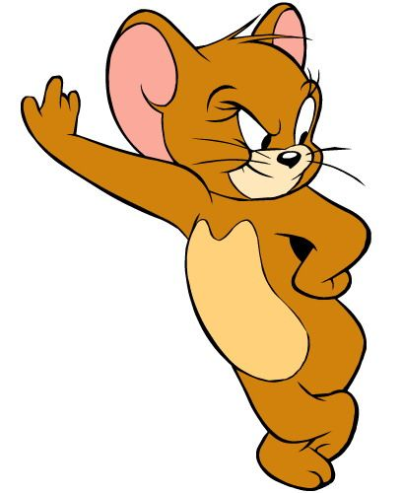

What is a Raspberry Pi ?

Slide 3
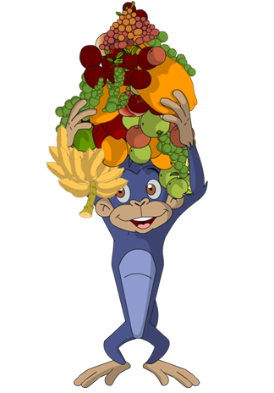

Slide 4
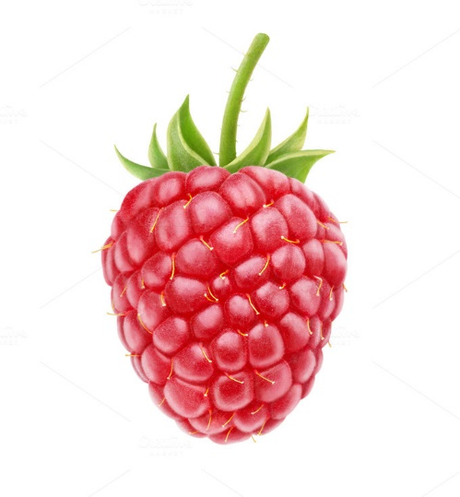
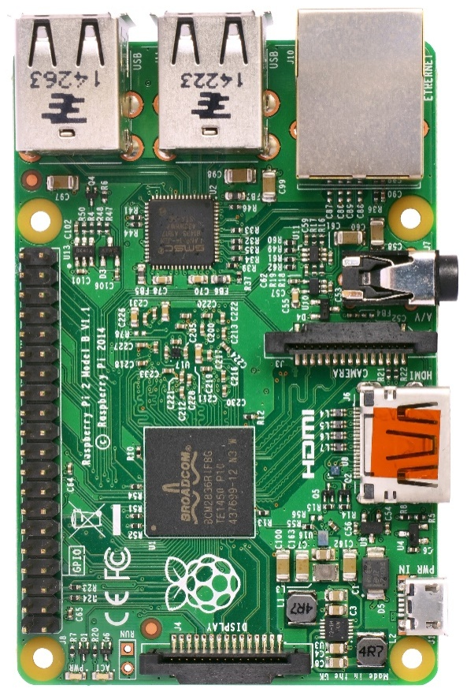
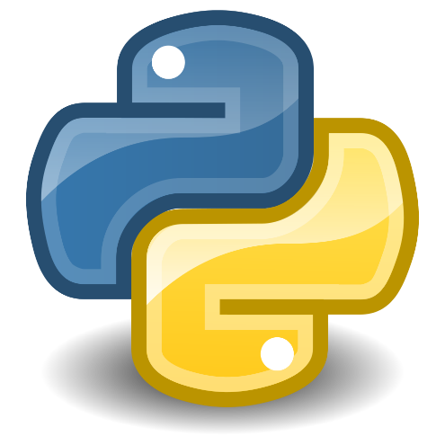
+ =

Slide 5
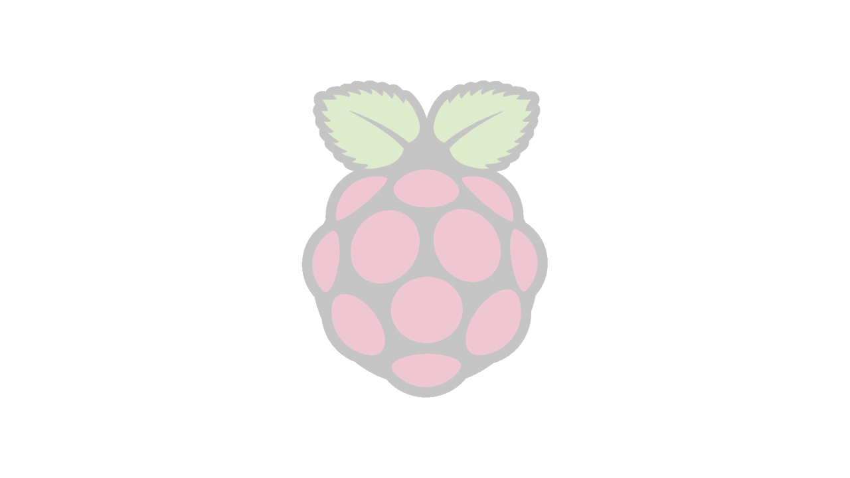
RASPBERRY PI
Enables people of all ages to explore computing, and to program in simple language like Python.
Is being used by kids all over the world to learn to program and understand how computers work.
It’s a mini card sized PC

Slide 6
RASPBERRY PI
The Raspberry Pi Foundation is a charity based in the UK

Slide 7
Capabilities

Slide 8
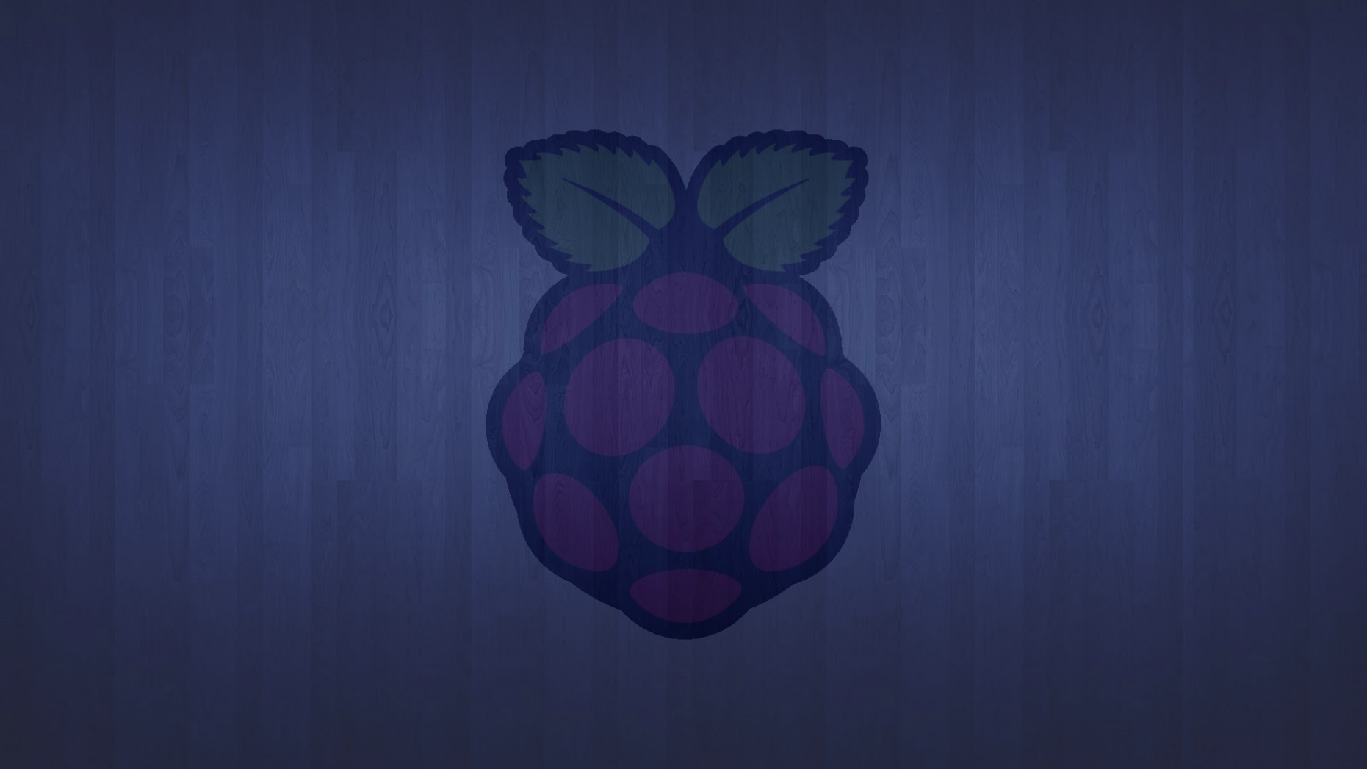
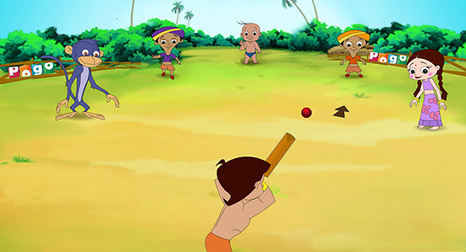
PLAY GAMES

Slide 9
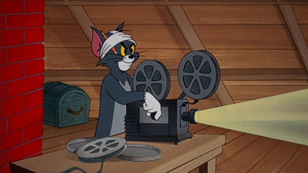
VIDEOS

Slide 10

PROGRAMMING

Slide 11

ELECTRONIC PROJECTS

Slide 12
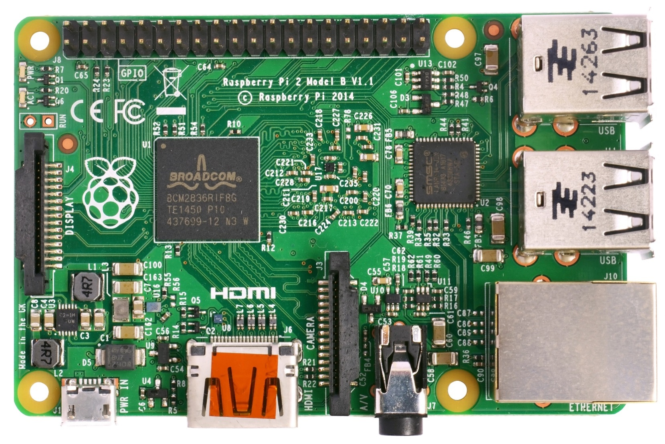
HDMI

Slide 13
HDMI
High-Definition Multimedia Interface

Slide 14
GPIO

Slide 15
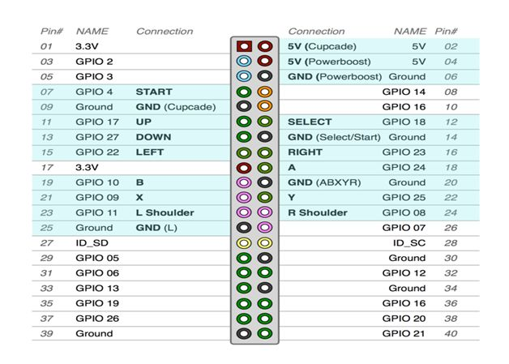
GPIO
GENERAL PURPOSE INPUT AND OUTPUT PINS

Slide 16
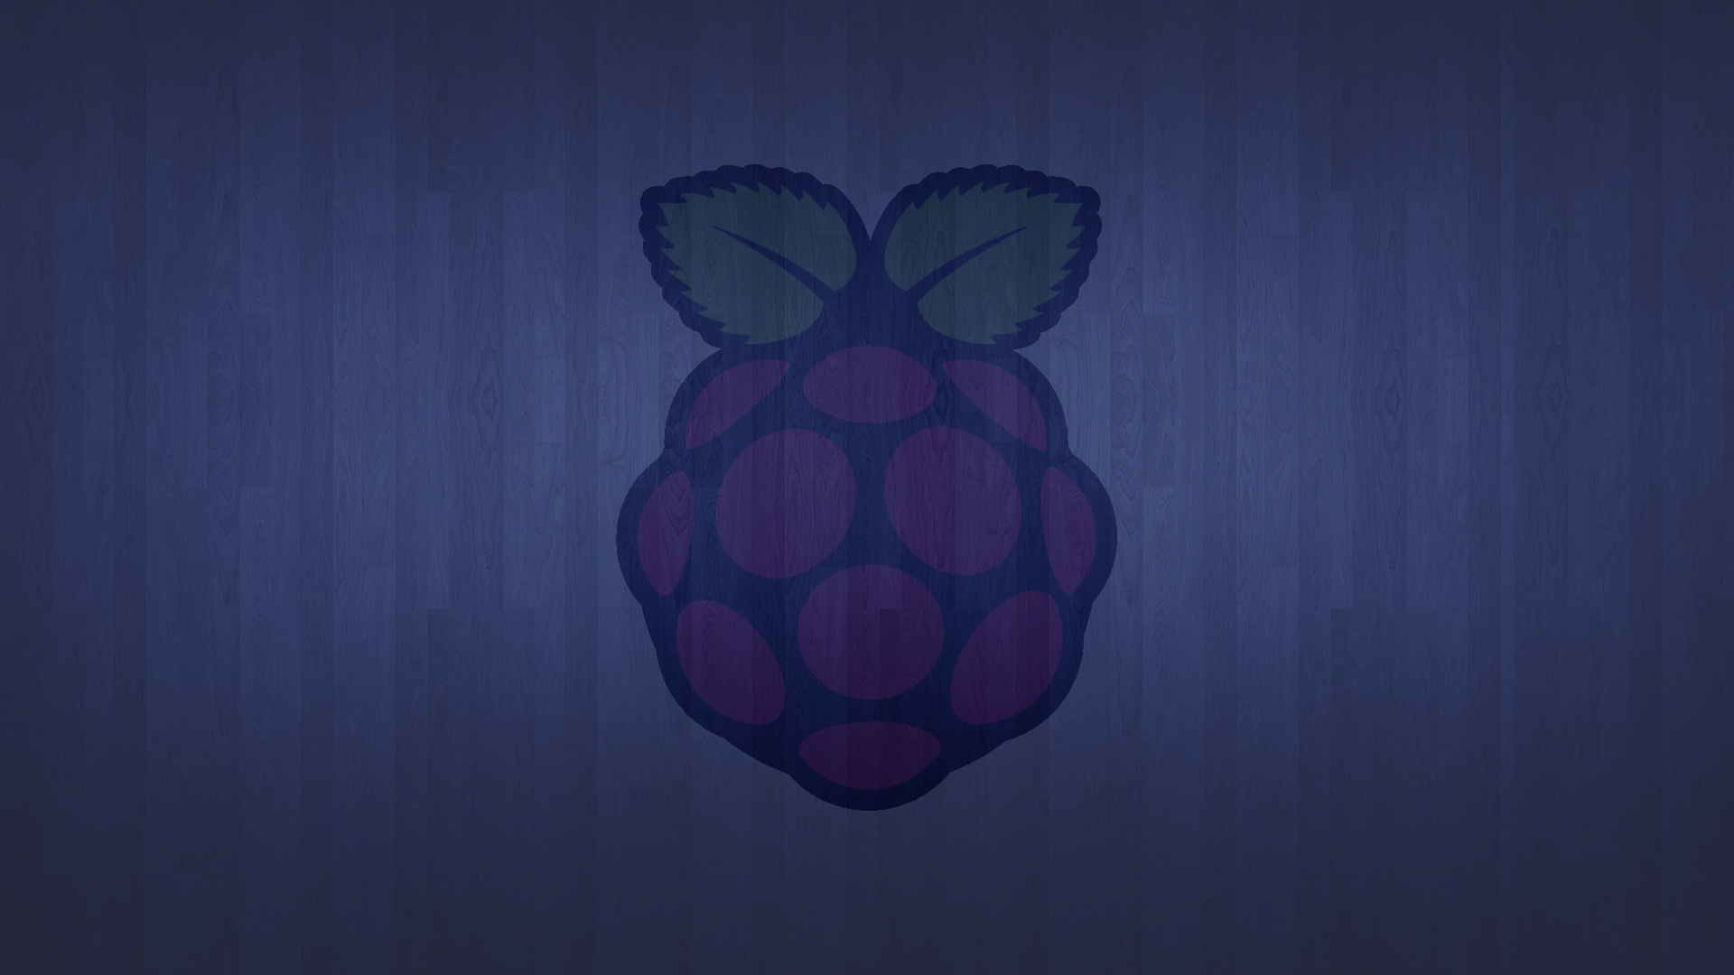
Raspberry Pi Input and output pins
RXD
TXD
5v,3.3v
GND
DNC
GPIO

Slide 17
USB
UNIVERSAL SERIAL BUS
HERE WE CAN CONNECT :
MOUSE
KEYBOARDS
PENDRIVES
WEBCAMERAS
ETC…

Slide 18
ETHERNET

Slide 19
ETHERNET
HERE WE CONNECT LAN (INTERNET) CABLE
USE INTERNET
UPGRADE SOFTWARES
DOWNLOADS ETC..

Slide 20
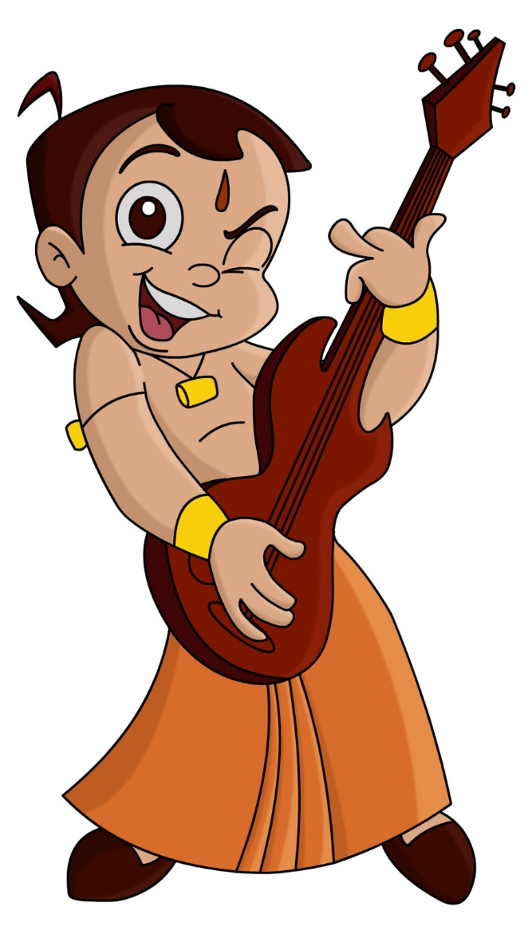
3.5mm AUDIO OUTPUT

Slide 21
POWER SUPPLY 5V 1A

Slide 22
DISPLAY

Slide 23
CAMERA

Slide 24
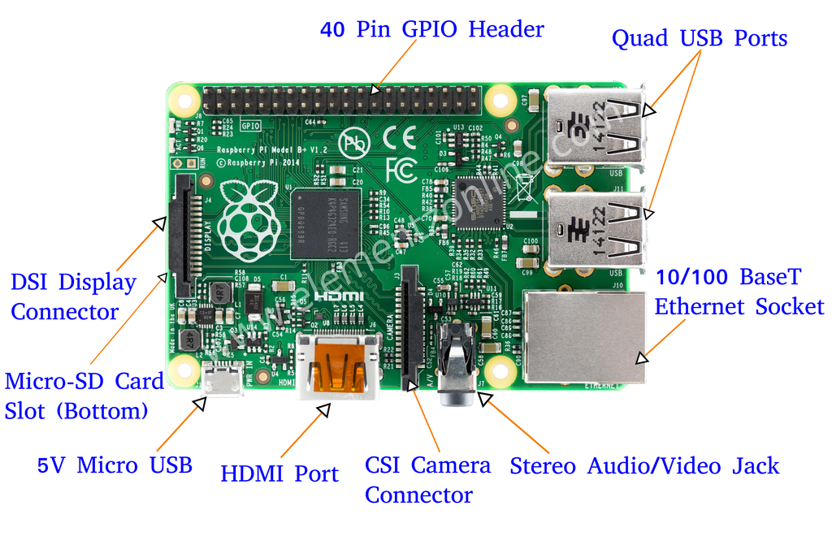

Slide 25
General Essentials:
Prepared Operating System SD Card
USB keyboard & mouse
Display (with HDMI)
Internet connectivity - LAN cable

Slide 26
Raspberry pi advantages
Small
In expensive
Less power consumption.
No need of purchasing any special license from raspberry pi foundation

Slide 27
U
S
B
(4)

Slide 28
Programming Languages
Installed by default on the Raspberry Pi:
C
C++
Java
Scratch
Ruby
Python

Slide 29
Python
The Raspberry Pi Foundation recommends Python
Python is a widely used general-purpose, high-level programming language.
Its syntax allows programmers to express concepts in fewer lines of code.
Free and open source.

Slide 30
OS OPERETING SYSTEM
Is the low-level software that supports a computer's basic functions

Slide 31
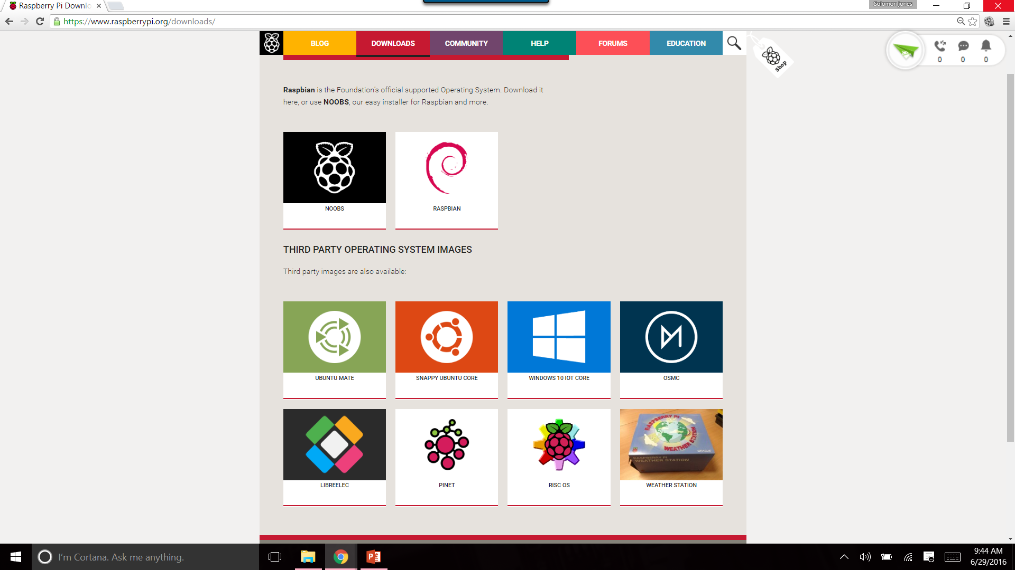
OPERETING SYSTEMs

Slide 32
RASPBIAN(0S)
RASPBERRY+DEBIAN
=
RASPBIAN

Slide 34
DOWNLOAD THE OS www.raspberrypi.org

Slide 35
DOWNLOAD SD CARD FORMATTER
http://www.trendy.co.jp/sd/en/p_formatter.html

Slide 36
Download and install
Win32 Disk Imager from this link: http://sourceforge.net/projects/win32diskimager/files/latest/download
Unzip it.

Slide 37
OPEN SD CARD FORMATTER
SELECT THE DRIVE TO FORMAT.
THEN FORMAT THE DRIVE

Slide 38
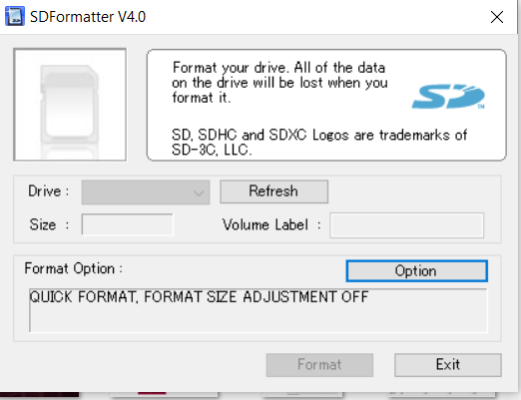

Slide 39
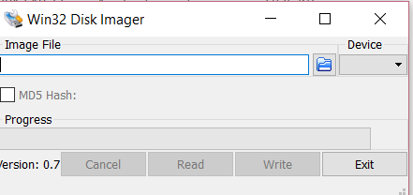
2.OPEN WIN 32
SELECT THE IMAGE FILE.
WRITE

Slide 40
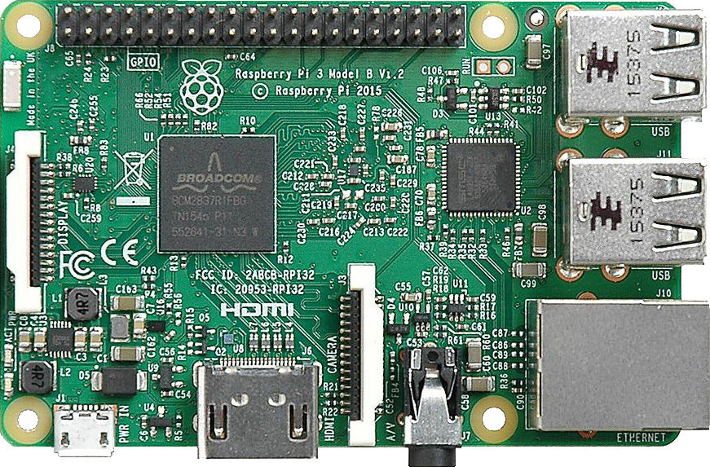
Raspberry Pi 3 Model B
Release date :29 February 2016
Dimensions :871 × 573

Slide 41
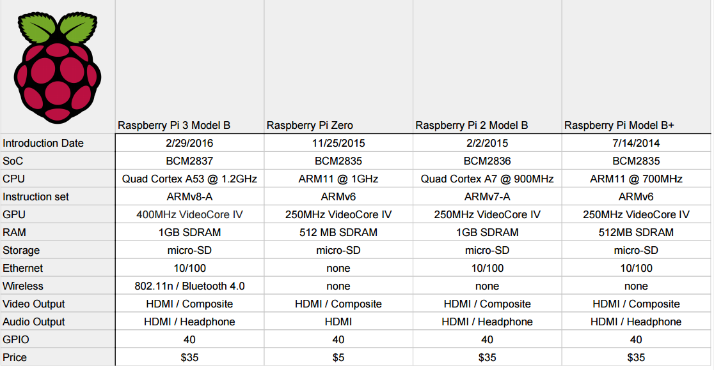

Slide 42


